Slide 1
VARIABLE AND CONSTANTS

Slide 2
Variable/Constants
Variable is a name given to a storage location in memory
Constant is an immutable value

Slide 3



Declaring Variables /Constants
To declare a variable we use the variable datatype followed by the variable name, then you can choose to initialize the variable or initialize later.
We can not print/use a uninitialized variable
To declare a constant we have to use the const keyword followed by the datatype then the variable name and with constants we have to initialize them

Slide 4
C# Identifiers Rules
An identifier is the name you assign to a type (class, interface, struct, record, delegate, or enum), member, variable, or namespace.
Valid identifiers must follow these rules:
Identifiers must start with a letter or underscore (_).
Identifiers may contain Unicode letter characters, decimal digit characters, Unicode connecting characters
Identifier cannot be a reserved keyword
You can declare identifiers that match C# keywords by using the @ prefix on the identifier. The @ is not part of the identifier name. For example, @if declares an identifier named if.
Always use meaningful names e.g. instead of data say studentMarks

Slide 5

Naming convention
camelCase : firstName
Pascal Case :FirstName
Hungarian Notation : strFirstName
Common Naming Conventions:
For local variables use camel case
For constants use Pascal case

Slide 6
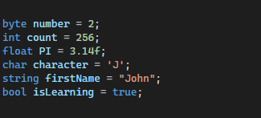
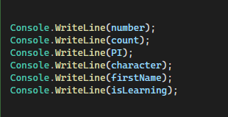

More on variables

Slide 7
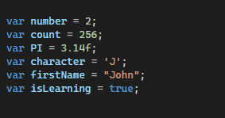
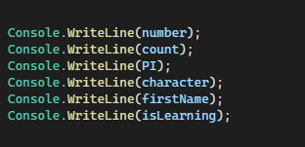

Using The var keyword
var data type was introduced in C# 3.0. var is used to declare implicitly typed local variable means it tells the compiler to figure out the type of the variable at compilation time. A var variable must be initialized at the time of declaration.
For byte however you have to explicitly cast it because the compiler will assign int.

Slide 8
Type Conversion
What is Type Casting
This is the C# process of changing one data type value into another data type. Type conversion is only possible in data types that are compatible with each other . If a datatype is not compatible we get a compile time error.
Types of Type Casting
Implicit type conversion
Explicit type conversion (casting)
Conversion between non-compatible types

Slide 9
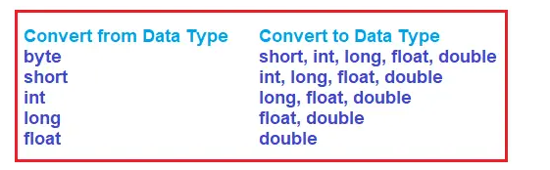
Implicit Type Casting
This is automatically done by the compiler and there will be no data loss. The Type casting is done from a smaller data type to a larger data type.
This Conversion happens when :
The two data types are compatible
When we assign a value of a smaller data type to a bigger data type.
The following is a diagram to illustrate possible conversions

Slide 10
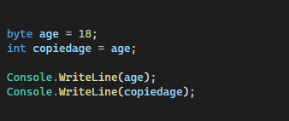

Example of implicit Type Casting

Slide 11


Explicit Type Conversion
If you want to convert the large data type to a smaller data type in C# , them you need to use explicit casting.
Here we convert large data types (like double, long) to smaller data types like (int, byte, short, float).
There is a chance of data loss or failed conversion for some reasons , so this is unsafe type of conversion.
But where is 232 coming from ? (1000- (256 *3))

Slide 12


Conversion between non-compatible types
For conversion with non- compatible types we use helper methods in C#.
Its impossible to convert this either implicitly or explicitly so for this example dotnet provides us with a class known as Convert, Parse Method and TryParse.

Slide 13
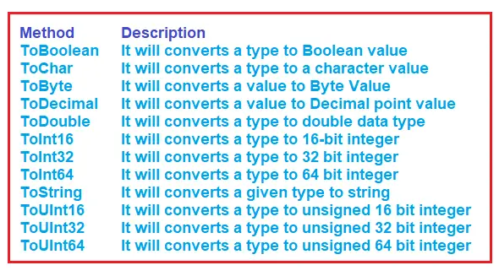
Convert Class Helper Methods In C#
The Convert class has a static methods which can be used to convert to a desired type. If the conversion is not possible I throws an error.
Here are the Methods :

Slide 14
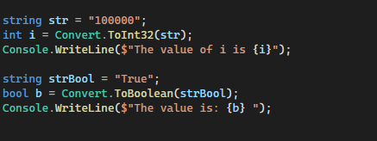

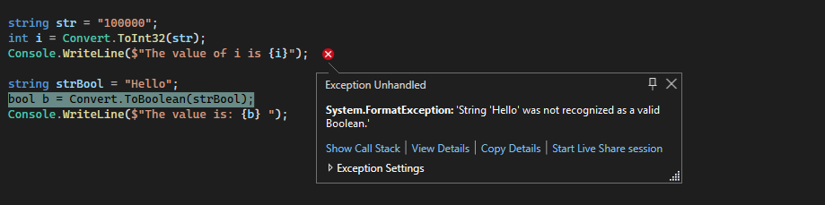
Example with Convert Class

Slide 15
Parse() Method

